Slide 1
Colored 2D and 3D Results
Keshav Shivam

Slide 2
Development Progress
3D Fiber Extraction code was already written in C++ and wrapped in a mex
Utilized plot, plot3, hold on, and randomized RGB color values to generate colored images

Slide 3
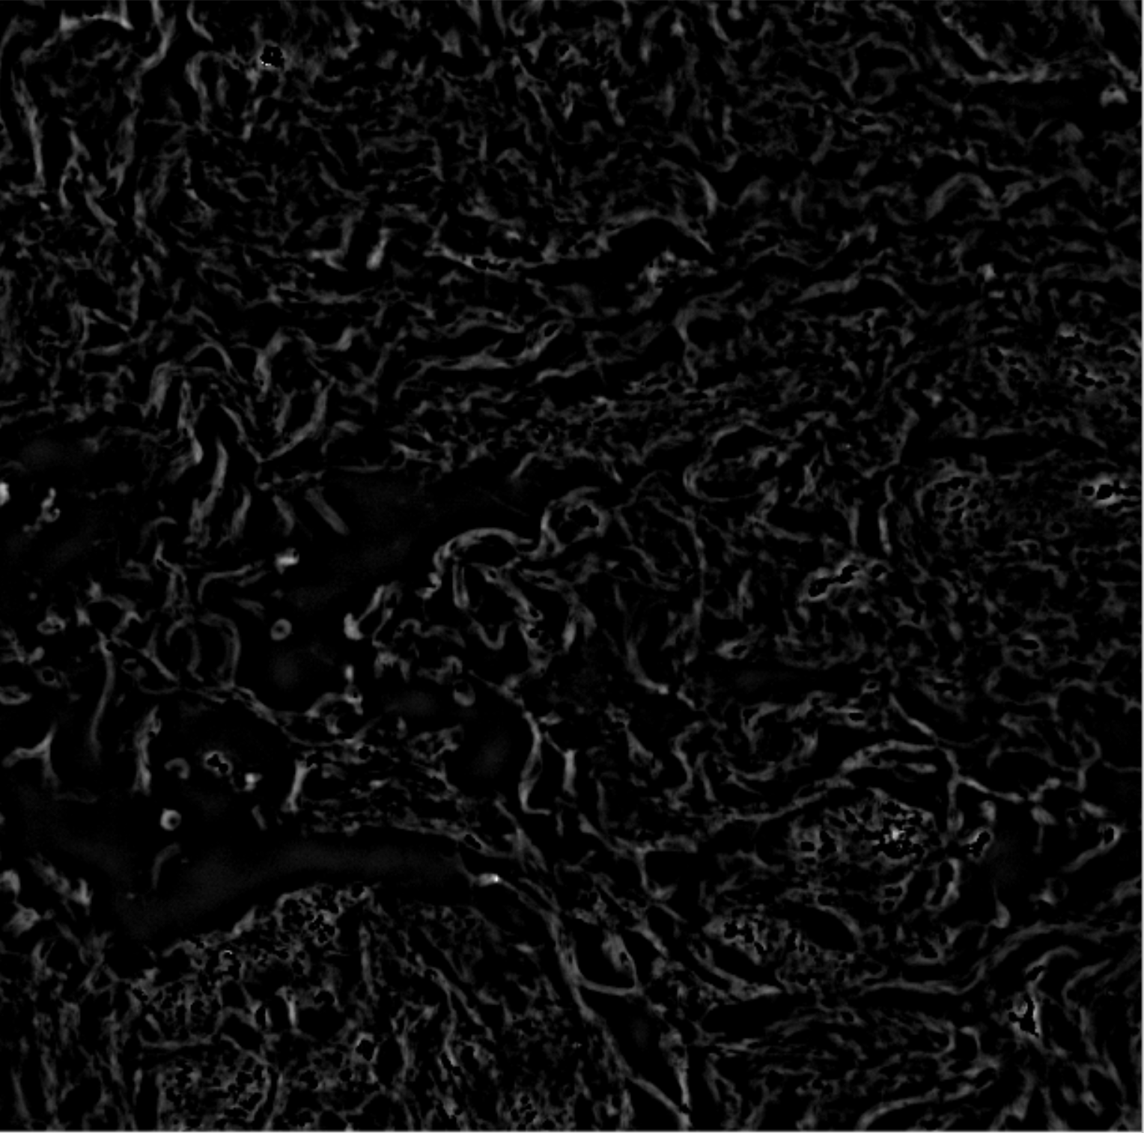
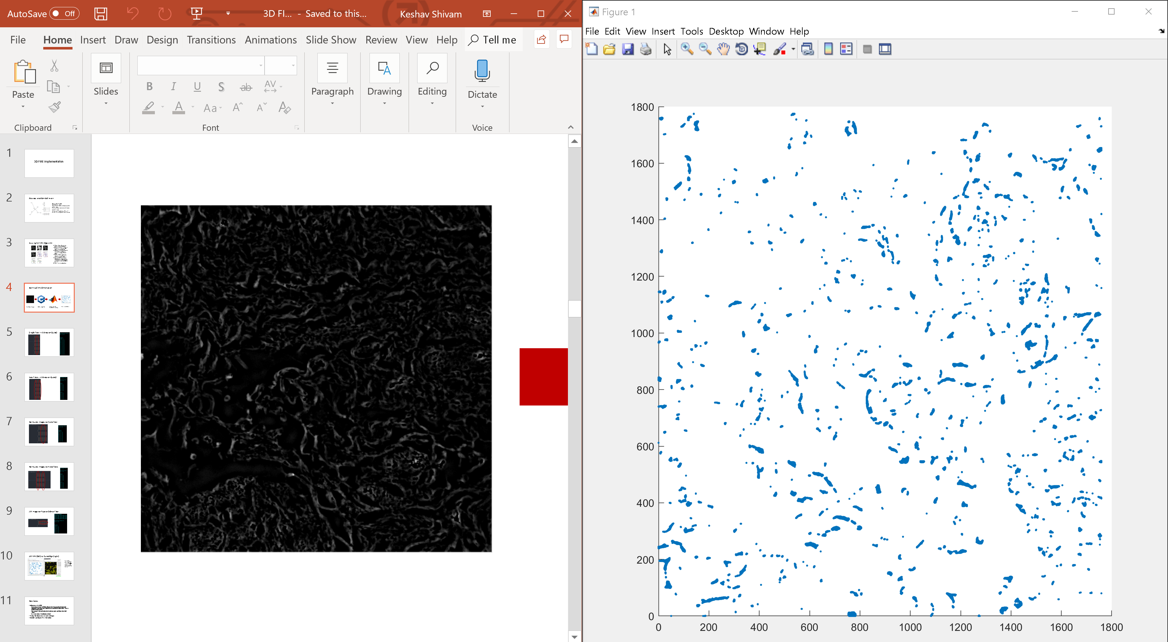
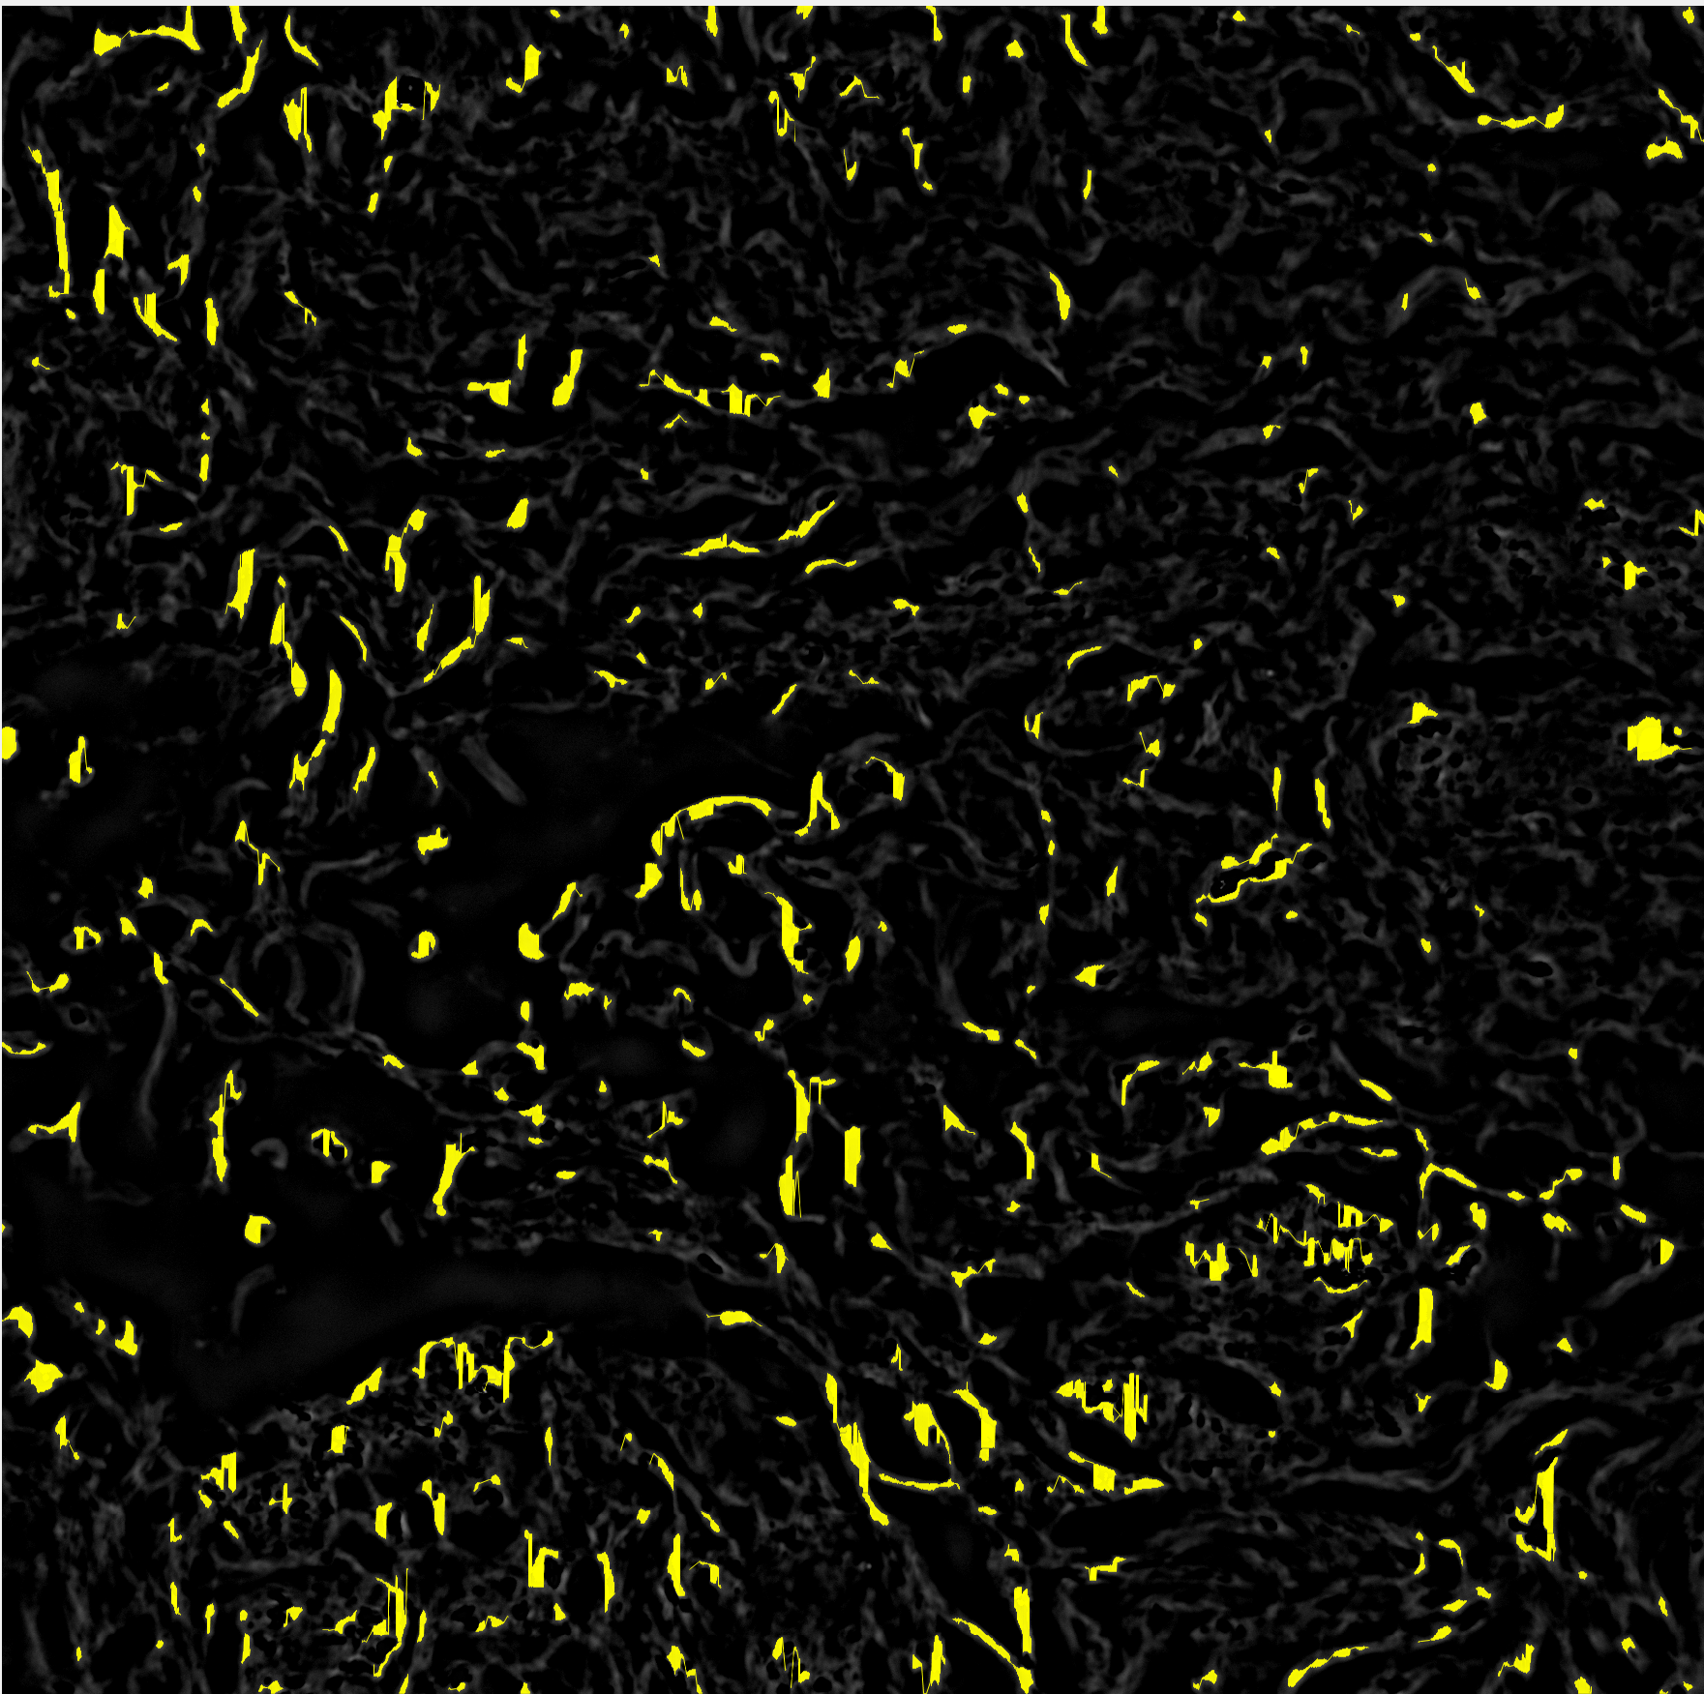
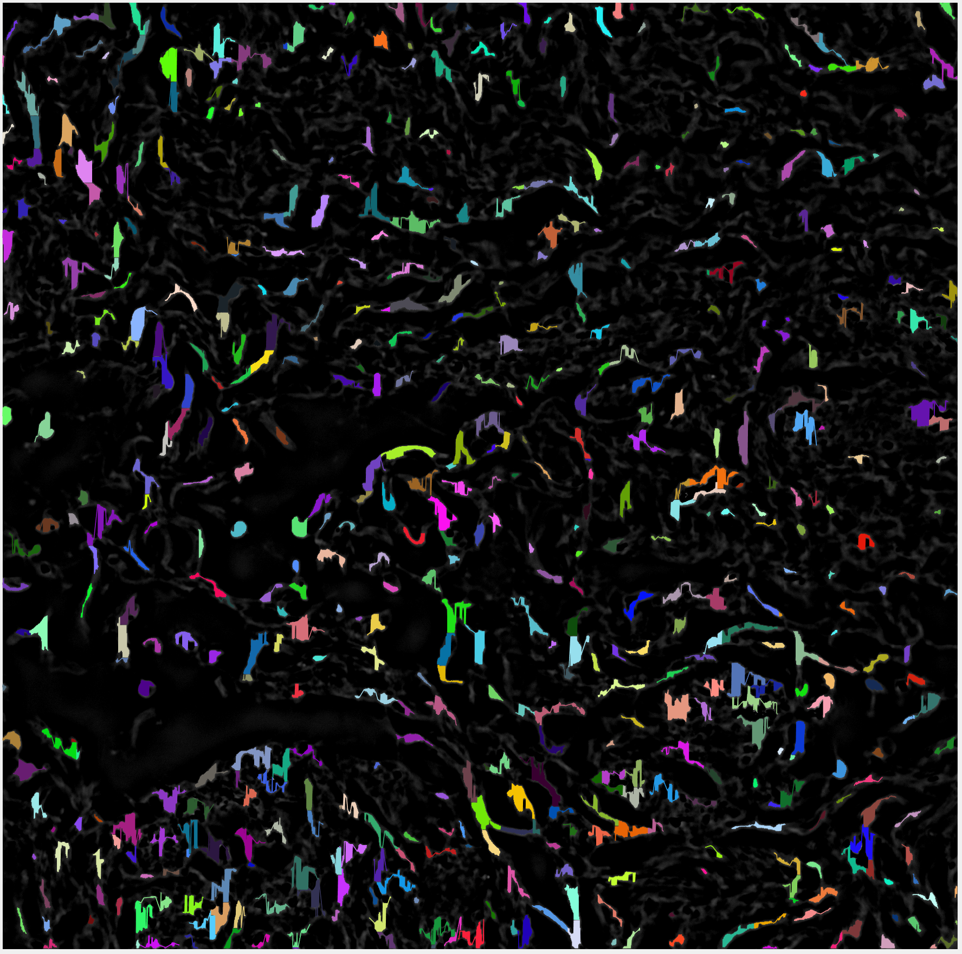
Ran in ~1 hrs, with randomized colors
fibers = FiberFinder(1, rows, cols, imgArray, 0.15, 4.5, 2, 10, 0);
32,000 nucleation points were expanded
Binary threshold too high

Slide 4
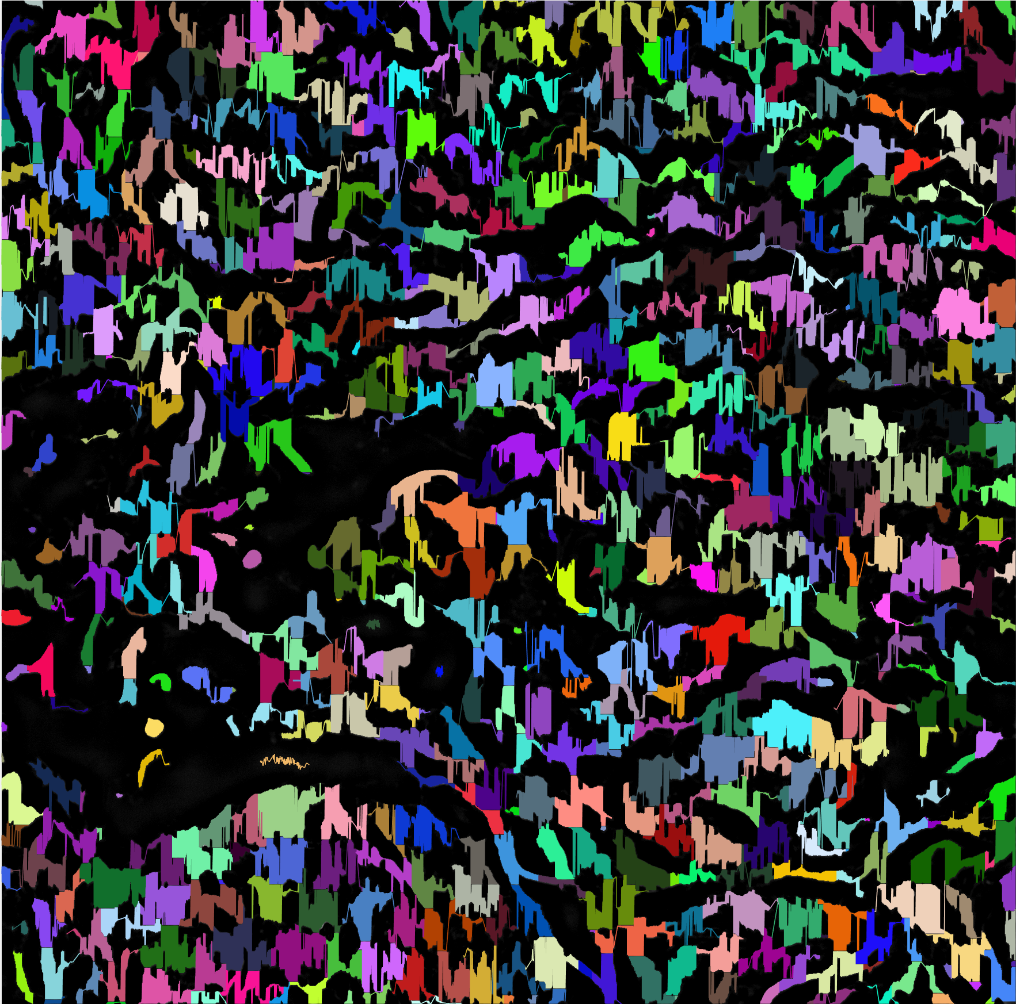
Ran in ~1 hrs
fibers = FiberFinder(1, rows, cols, imgArray, 0.05, 4.5, 2, 13, 0);
320,000 nucleation points were expanded
Lmp box radius was too low, fibers had straight lines

Slide 5
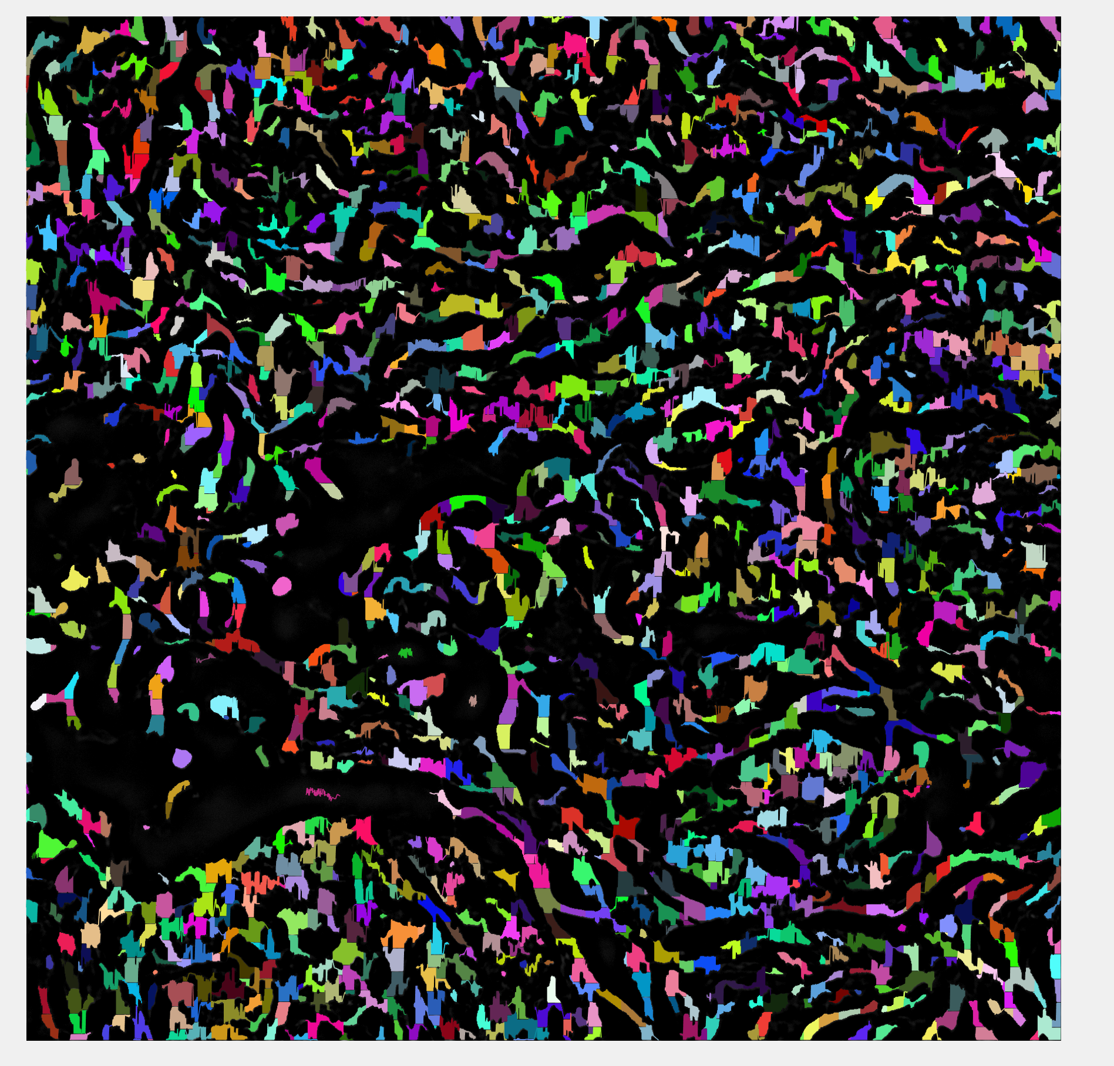
Ran in ~3 hrs, left it on overnight
fibers = FiberFinder(1, rows, cols, imgArray, 0.05, 10, 2, 13, 0);
32,000 nucleation points were expanded

Slide 6
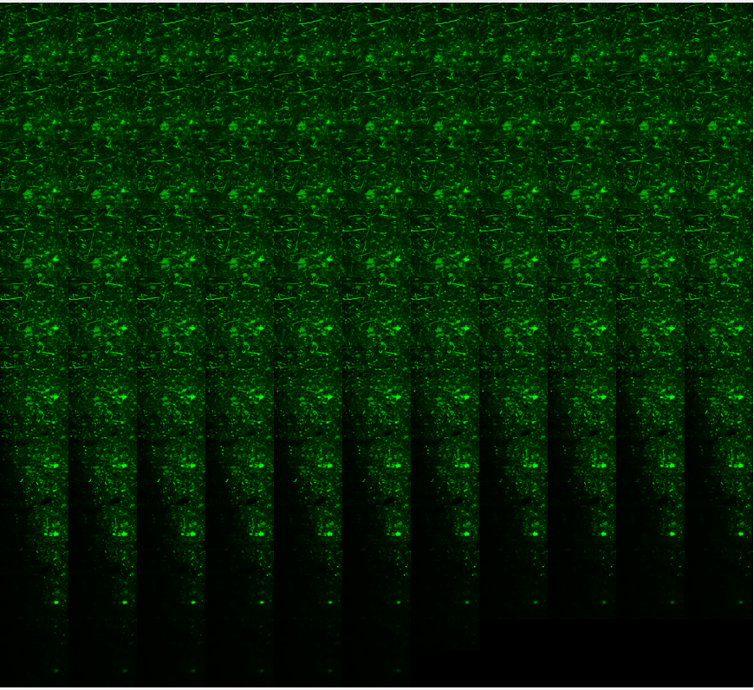
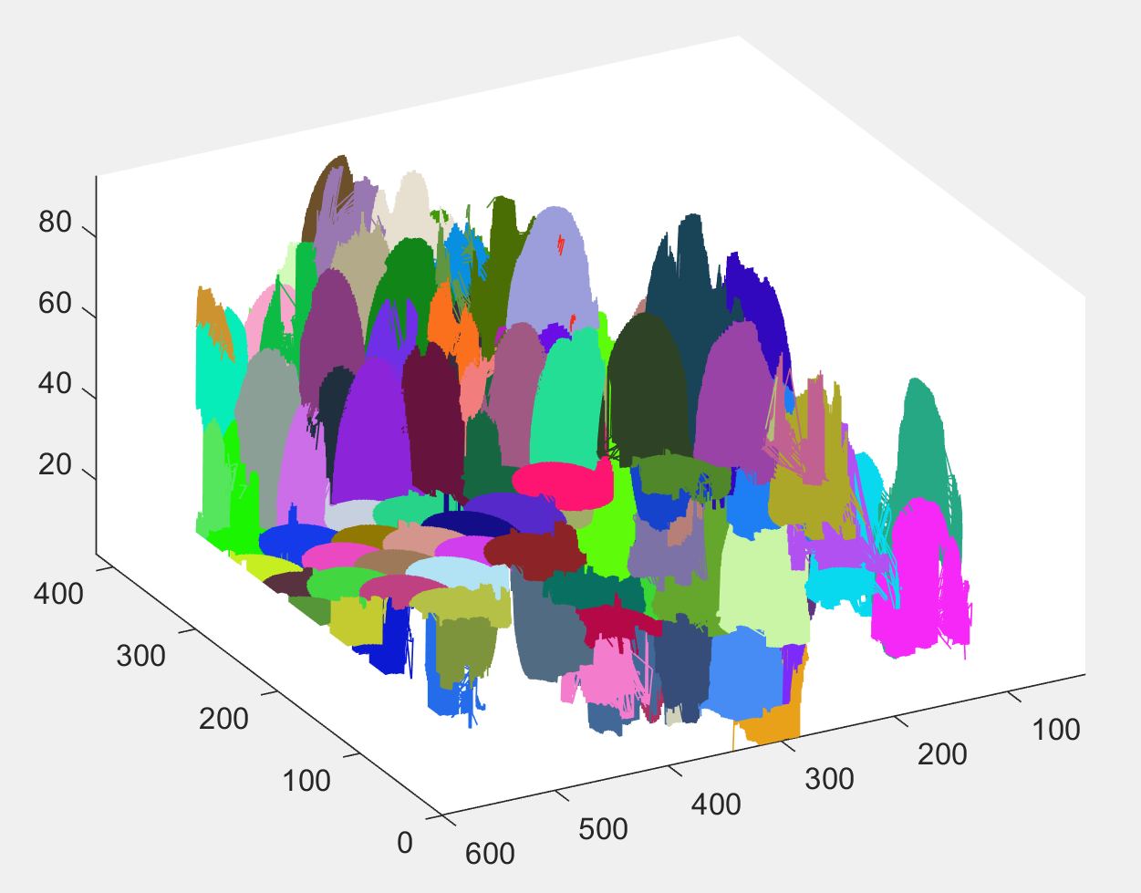
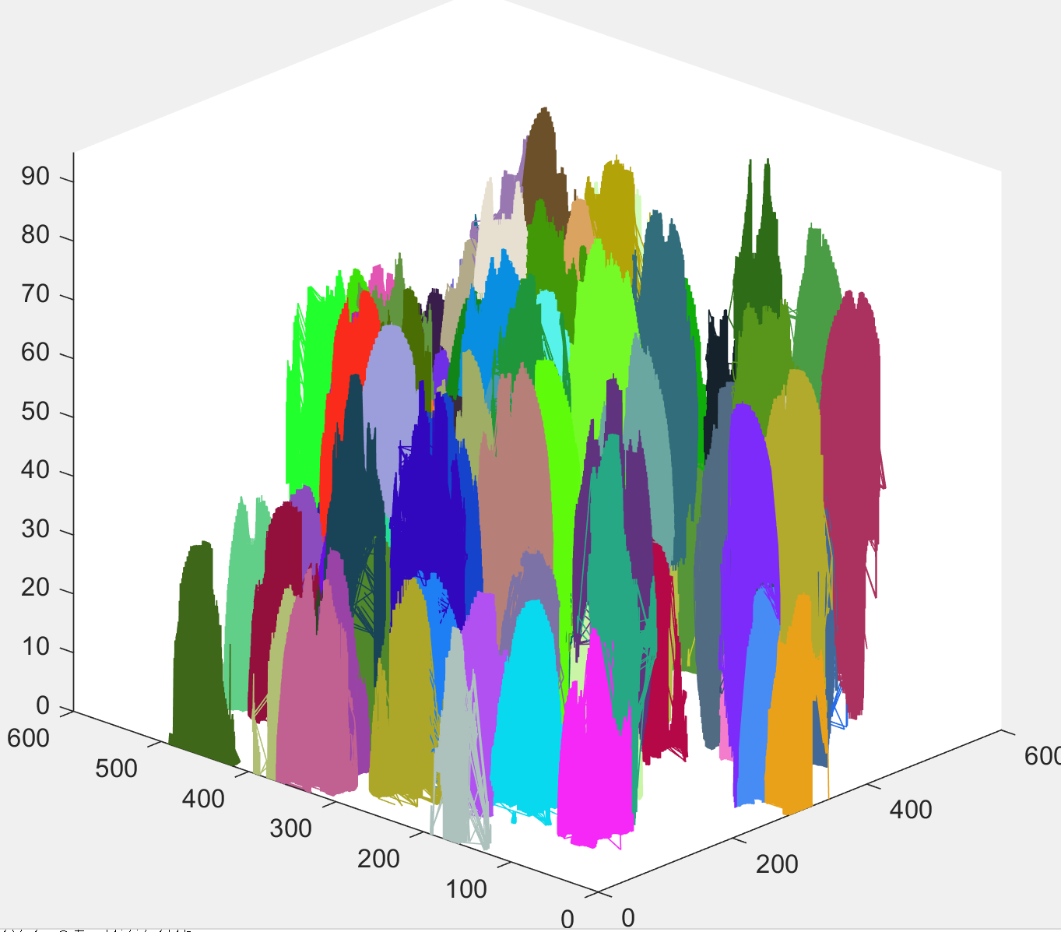
3D Test of 105 Fluorescent Images
Originally took 8-9 hours to run, after optimizing the algorithm only took 2.5 hours
fibers = FiberFinder(depth, height, width, imgArray, 13, 50, 5, 20, 30);
900,000 nucleation points, but those included in a fiber were not re-expanded

Slide 7
Next Steps
Identify best parameters for fiberFinder when using 3D image stacks
Optimize C++ code further to reduce analysis time
Create histograms of average angle and length of fibers

